Slide 1
JUST CAUSE TERMINATION
Jeff Mandel (407) 541-0850 jmandel@fisherphillips.com

Slide 2
Just Cause: A Little History

Slide 3
Enterprise Wire (1966)
Employee terminated for poor performance and refusal to work
CBA gave management right to discipline or discharge for “cause”
CBA did not define “cause”
No generally accepted legal definition of “cause” existed in the employment context

Slide 4
Arbitrator Carroll Daugherty
The “seven tests” of just cause
seven questions, all of which have to be answered affirmatively, to show discipline was fair and reasonable
Widely, but not universally accepted
Has been described as “academic silly putty”
Notes:
Dennis Nolan and Roger Abrams have attacked it
Questions/Tests are entirely subjective.

Slide 5
Expansion of Just Cause
Civil Service
Employment policies
Especially in the public sector
Employment litigation
Juries
Notes:
Civil Service – PERC, MSPB

Slide 6
Expansion of Just Cause
Proper Cause
Cause
Arbitrary or capricious
Pursuant to policies
Arbitrators tend to apply just cause regardless of the identified standard
Notes:
Civil Service – PERC, MSPB

Slide 7
Is It Required In A CBA?
Section 447.401, Florida Statutes:
Each public employer and bargaining agent shall negotiate a grievance procedure to be used for the settlement of disputes between employer and employee, or group of employees, involving the interpretation or application of a collective bargaining agreement. Such grievance procedure shall have as its terminal step a final and binding disposition by an impartial neutral, mutually selected by the parties.

Slide 8
Is It Required In A CBA?
Teamsters Local Union 385 v. City of Winter Park
38 FPER P360 (Fla. PERC 2012)
107 So. 3d 411 (Fla. 1st DCA 2013)

Slide 9
The Seven Tests of Just Cause

Slide 10
Test 1
Was the employee forewarned of the possible disciplinary consequences of his or her conduct?
Work Rules
Penalties
Common Sense?
Notes:
Not only have them, but proof of receipt
Caveat of deviating from guidelines

Slide 11
Test 2
Is the employer’s rule reasonably related to the orderly, efficient, and safe operation of the employer’s business and the performance that the employer might properly expect?
Unreasonable
Arbitrary, Capricious, or Discriminatory
Contrary to CBA

Slide 12
Test 3
Did the employer, before taking discipline, make an effort to discover whether the employee did in fact violate the rule?
This test focuses on process
Industrial due process
LEO and FF Bills of Rights

Slide 13
Test 4
Was the employer’s investigation conducted fairly and objectively?
Who conducted it
Who was interviewed
What evidence was considered

Slide 14
Steps For Conducting Investigations
Secure written complaint
Select investigator
Develop action plan
Gather evidence
Conduct interviews
Preserve investigative information
Issue report

Slide 15
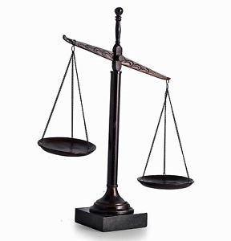
Test 5
Did the employer obtain substantial evidence of the employee’s guilt?
Type of Proof
Direct evidence
A fact seen or heard by the witness
Circumstantial evidence
A fact established by a reasonable inference
Hearsay evidence
A fact based on what someone else told the witness
Notes:
Use pornography on computer example
-discuss hearsay v. admission

Slide 16
Test 5
Did the employer obtain substantial evidence of the employee’s guilt?
Burden of Proof
Preponderance of the evidence
Tipping the scales
Clear and convincing evidence
Substantially more likely than not
Beyond a reasonable doubt
No other logical explanation can be derived

Slide 17
Fact Scenario
Police Department receives complaint from mother of 17-year old daughter that officer had off-duty sex with daughter
I.A. conducted
17-year old testifies sex happened and she told officer she was 17 years old before sex
Officer admits sex, but claims girl showed him ID before sex that she was 19 years old
SAO decides not to prosecute after mother and daughter decline to testify
Department relies on I.A. report at arbitration

Slide 18
Performance Terminations
Do past performance evaluations support the decision?
Sudden deterioration in performance after many years of acceptance
Good evaluations for poor performance
Was the employee given adequate notice
“Squirreling” complaints, rather than addressing each in a timely, appropriate fashion

Slide 19
Performance Terminations
Was the employee provided the tools to improve?
Advised how to improve
Provided training as needed
Told when he/she needed to meet expectations
Follow-ups
Is the articulated reason for the termination the real reason?

Slide 20
Test 6
Were the rules applied fairly and without discrimination?
Disparate treatment
Will this employee be receiving the same discipline as others who violated the same rule or standard?
Is there a legitimate basis for treating the employee differently?

Slide 21
Test 7
Was the degree of discipline reasonably related to the seriousness of the employee’s offense and the employee’s past record?
Seriousness of the infraction
Employee’s disciplinary history
Employee’s length of service
Employee’s total performance record

Slide 22
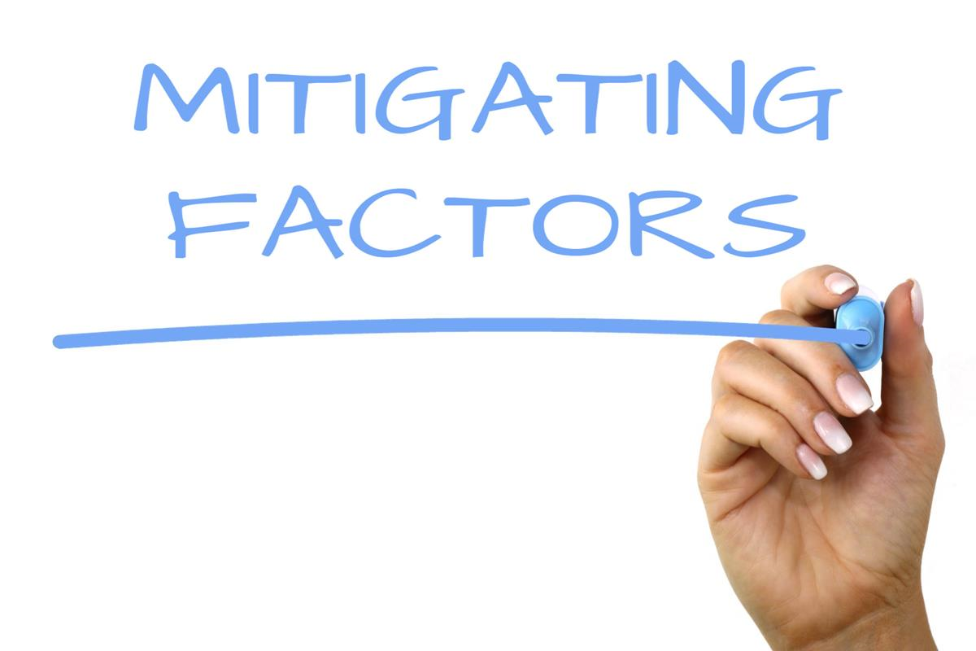
The Missing Tests
Progressive Discipline
Policies/Contract
Correct, not punish
Mitigating/Extenuating Circumstances
Impossibility
Provocation
Failure to train
Medical condition

Slide 23
Key Elements For All Discipline
Consistent
Timely
Impartial
Progressive
Appropriate
Keep “C.L.E.A.N”

Slide 24
The “C.L.E.A.N” Rule
Consider the facts
Learn the employee’s, manager’s and witnesses’ stories
Evaluate prior discipline for similar offenses
Analyze risk
Narrow potential options and decide

Slide 25
What To Consider
The most important considerations in deciding on what disciplinary action to take:
Correction desired
Implications
Legal defensibility

Slide 26
Legal Defensibility
Is the employee in a protected status?
Has the employee complained about anything verbally or in writing?
Has the employee recently filed a worker’s compensation claim?
Will the termination of the employee prevent the vesting of benefits?
How will an arbitrator or jury view it?

Slide 27
In Sum – Misconduct Discipline
Did the employee violate an established rule?
Was the rule known to the employee?
Was the practice consistent with the rule?
Have appropriate disciplinary steps been followed?
Is the discipline consistent with past practice?

Slide 28
In Sum – Performance Discipline
Do past performance evaluations support the decision?
Is the deficiency capable of objective measurement, or are the criticisms at least specific?
Does the employee’s overall documented record support the decision?
Was the employee ever told his/her failure to improve would result in termination?

Slide 29
In Sum – Performance Discipline
Was the employee not only told of deficiencies but also advised how to improve?
Did the employee ask for help to improve and was denied?
Is the articulated reason for the termination the real reason?
Is this action consistent with prior incidents of a similar nature?

Slide 30
Common Mistakes to Avoid
Sudden deterioration in performance after many years of acceptance
“Squirreling” complaints, rather than addressing each in a timely, appropriate fashion
Good evaluations for poor performance
Avoiding direct and honest statements of the reasons for disciplinary actions

Slide 31
Final Questions

