Slide 1
Using Emotional Intelligence
to Achieve Peak Performance
davidalba007@gmail.com

Slide 2
Be Prepared
Please check your pockets, purse, briefcase, cell phone, wallet for an item that “speaks” about who you are.
It could be a photo, jewelry, membership card, screen photo, memento, stub, souvenir, etc.

Slide 3
Emotional Intelligence History
Mayer & Salovey
Thorndike
Goleman
Darwin
Bar-On

Slide 4
EQ Definitions
Formal Definition: the ability to use your emotions to form an optimal relationship with yourself and others.
Daniel Goleman Definition: the capacity for recognizing our own feelings and those of others, for motivating ourselves and for managing emotions well in ourselves and others.

Slide 5
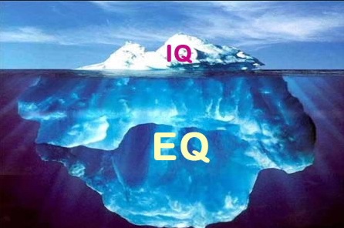
EQ = Emotional Intelligence

Slide 6
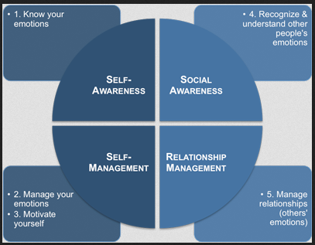
Goleman’s EQ Model

Slide 7
EQ Findings
High EQ people are happier, healthier and more successful in relationships.
High EQ people exhibit:
Balance between emotion and reason
Awareness of their own feelings
Empathy and compassion for others
Signs of high self-esteem
We aren’t all created emotionally equal - we have different emotional temperaments.
The way we act out, express ourselves, and use our emotions can be changed!

Slide 8
EQ at Work
70% of the reasons for losing a customer are EQ related.
59% of workers report they do not receive recognition for a job well done.
75% of workers say they do not find management’s leadership inspiring.
50% of time wasted in the workplace is due to the lack of trust.
Everyday 50,000 people quit their jobs.
85% of workers report they could work more effectively.
80% of Americans do not look forward to going to work.

Slide 9
EQ at Work (cont)
EQ is greater than 85% of what enables “star performers” to develop into great leaders.
EQ allows people to think more clearly under pressure, eliminating time wasted by anger, anxiety and fear.
As a determinant of high performance, EQ is twice as important as technical and cognitive skills combined.
Workers with high EQ get along better and solve problems more efficiently.
Workers with high EQ positively impact people they interact with – they are good role models of excellent performance.

Slide 10
Goleman’s EQ Model

Slide 11
Self-Awareness
Self-awareness means having a deep understanding of one’s emotions…how their feelings affect them, other people and their job performance…
Daniel Goleman

Slide 12
Self-Awareness
People with high skill levels of self-awareness:
Interact easily with team members and clients who are demanding.
Make decisions in a calm state of mind.
Accurately assess themselves and exhibit openness.
Are quietly self-confident.
Accurately assess people and situations.

Slide 13
Components of Self-Awareness
Emotional Awareness - recognizes one’s emotions and their effects.
Accurate Self-Assessment - knowing one’s strengths and limits.
Self-Confidence - a strong sense of one’s self-worth and capabilities.

Slide 14
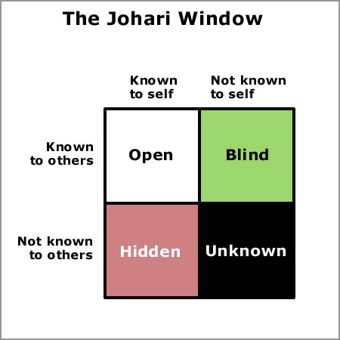
Components of Self-Awareness
Accurate Self-Assessment

Slide 15
Components of Self-Awareness
Self-Confidence
Understand your talent
Suspend self-doubt and push through feelings of self-doubt to boost confidence

Slide 16
Self-Awareness Activity
Name That Emotion

Slide 17
Actions to Build Self-Awareness
Develop habit of self-observation
Spend time daily on self-reflection
Keep a journal
Ask for feedback

Slide 18
Goleman’s EQ Model

Slide 19
Self-Management
Self-management, which is like an on-going inner conversation, is the component of EQ that frees us from being prisoners of our feelings. People engaged in such a conversation…find ways to control (emotional impulses) and even to channel (emotions ) in useful ways…
Daniel Goleman

Slide 20
Components of Self-Management
Self-Control
Trustworthiness
Conscientiousness
Adaptability
Innovation

Slide 21
Self-Management
The ultimate act of personal responsibility at work may be taking control of our own state of mind.
Daniel Goleman

Slide 22
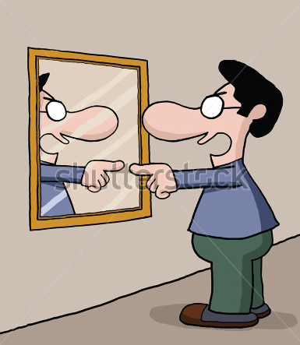
Self-Management Activity
Self-talk
Constructive Inner
Dialog Activity
What Are You Telling
Yourself Lately Activity?
OR

Slide 23
Actions to Build Self-Management
Develop constructive inner dialogs
Avoid distorted thinking
Overgeneralizations
Destructive labeling
Derail counterproductive behavior
Sarcasm
Avoidance
Boastfulness
Use humor
Redirect your emotional energy
Take time out to relax
Behavior rehearsal

Slide 24
Goleman’s EQ Model

Slide 25
Self-Motivation
(People who possess self-motivation skills) are driven to achieve beyond expectations…The key word here is achieve…They are motivated by a deeply embedded desire to achieve for the sake of achievement (alone)…
Daniel Goleman

Slide 26
Self-Motivation
People with high skill levels of self-motivation:
Initiate improvements in their jobs, departments and division
Succeed at difficult assignments more often than those with low self-motivation
Are less likely to quit their job or leave the organization
Motivate their staff and others they interact with
Magnetize a cadre of people around them with the same traits

Slide 27
Components of Self-Motivation
Achievement drive
Commitment
Initiative
Optimism

Slide 28
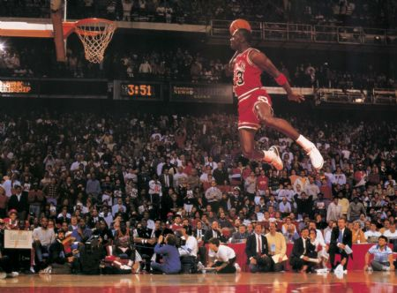
Self-Motivation Activity
Eye On the Goal

Slide 29
Actions to Build Self-Motivation
Use motivational self-statements (affirmations)
Use positive mental imagery
Find an emotional mentor
Create a healthy work environment

Slide 30
Goleman’s EQ Model
Empathy

Slide 31
Empathy
…empathy means thoughtfully considering employee’s (other’s) feelings - along with other factors - in the process of making intelligent decisions…
Daniel Goleman

Slide 32
Empathy
People with high skill levels of empathy:
Frequently inform people during times of change and uncertainty
Promote collaboration
Develop all staff to their potential
Develop and retain the intellectual capital of the organization
Achieve consistently high performance of direct reports
Enjoy increased job motivation and satisfaction of staff

Slide 33
Components of Empathy
Understanding others
Developing others
Serving others
Leveraging diversity
Political awareness

Slide 34
Empathy Notes
Understanding is not the same as agreement
Research suggests a negative correlation between being in positions of power and empathetic abilities
In a team oriented, customer focused organization, empathy is critical

Slide 35
Empathy Quiz – Thank you

Slide 36
Actions to Build Empathy
Look for the good and similar
Assume people have the best of intentions
Practice a “walk in their shoes”
Listen better
Try to identify with what the other person is saying and feeling (perhaps by reflecting on an experience you’ve had that produced a similar emotion in you)

Slide 37
Goleman’s EQ Model
Empathy

Slide 38
Managing Relationships
Adeptness at inducing desirable responses in others.
Daniel Goleman

Slide 39
Managing Relationships
People with high skill levels of managing relationships:
Can count on a wide circle of colleagues during difficult times
Find the “common ground” among differing views
Effectively leads teams
Achieve change initiative objectives

Slide 40
Components of Managing Relationships
Influence
Communication
Conflict management
Leadership
Change catalyst
Building bonds
Collaboration and cooperation

Slide 41
Actions to Build Managing Relationships
Know the relationship boundaries and expectations
Use appropriate self-disclosure
Keep confidences
Be enthusiastic
Listen more and talk less

Slide 42
Personal EI Development Plan

Slide 43
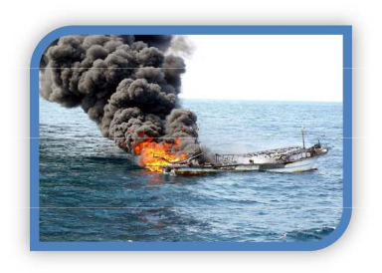
Survivor

Slide 44
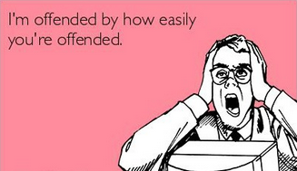
Key Strategy
Handle Conflict
Don’t offend
Don’t be offended.

Slide 45
Key Strategy
Handle Conflict
There are some things, I just don’t have to have an opinion on!

Slide 46
Key Strategy
Handle Conflict
Don’t assume motive.

Slide 47
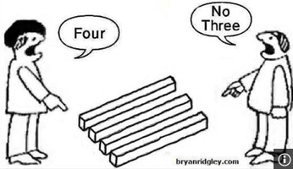
Key Strategy
Handle Conflict
Let’s agree to disagree, agreeably.

Slide 48
Proactive Approaches
P
P
A
A
C
C

Slide 49
Take the…
L isten
E mpathize
A pologize
D o something or Direct to someone who can

Slide 50
Saying “No” Nicely
N eutralize through a positive beginning
I mmediately empathize
C ourteously explain
E mphasize your desire to help

Slide 51
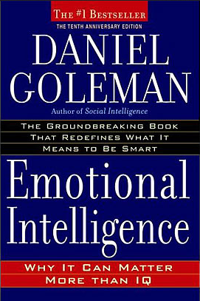
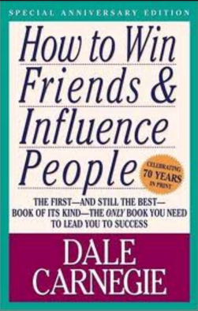
Thank you
My name is David Alba – davidalba007@gmail.com
If any of my stories aren’t true - they should’ve been.
Three books that I recommend:

