Slide 1
David Miklas Law Office of David Miklas, P.A. Representing Florida Employers Since 1998 www.MiklasEmploymentLaw.com facebook.com/FloridaEmploymentLaw
Duty to Reasonably Accommodate: the ADA, Title VII, and FMLA
April 22, 2020
Email: david@miklasemploymentlaw.com

Slide 2
In the past year, what was the most frequently filed charge of discrimination? (poll)
Race
B) Disability
C) Sex (gender)
D) Retaliation
www.hrflorida.org

Slide 3
On 1/24/2020 the EEOC released its FY 2019 data
Retaliation: 39,110 (53.8 percent of all charges filed)
Disability: 24,238 (33.4 percent)
Race: 23,976 (33 percent)
Sex: 23,532 (32.4 percent)
Age: 15,573 (21.4 percent)
National Origin: 7,009 (9.6 percent)
Color: 3,415 (4.7 percent)
Religion: 2,725 (3.7 percent)
Equal Pay Act: 1,117 (1.5 percent)
Genetic Information: 209 (.3 percent)
7,514 sexual harassment charges - 10.3 percent of all charges, and an 1.2 percent decrease from FY 2018.
www.hrflorida.org

Slide 4
Can we force employees to get a flu shot?
www.hrflorida.org

Slide 5
EEOC has been taking an aggressive stance on this issue.
Employer-mandated flu shots and other vaccines may violate some religious beliefs.
In January 2018 an employer paid $89,000 to settle a religious discrimination lawsuit after firing three workers who requested religious exemptions to flu shots.
www.hrflorida.org

Slide 6
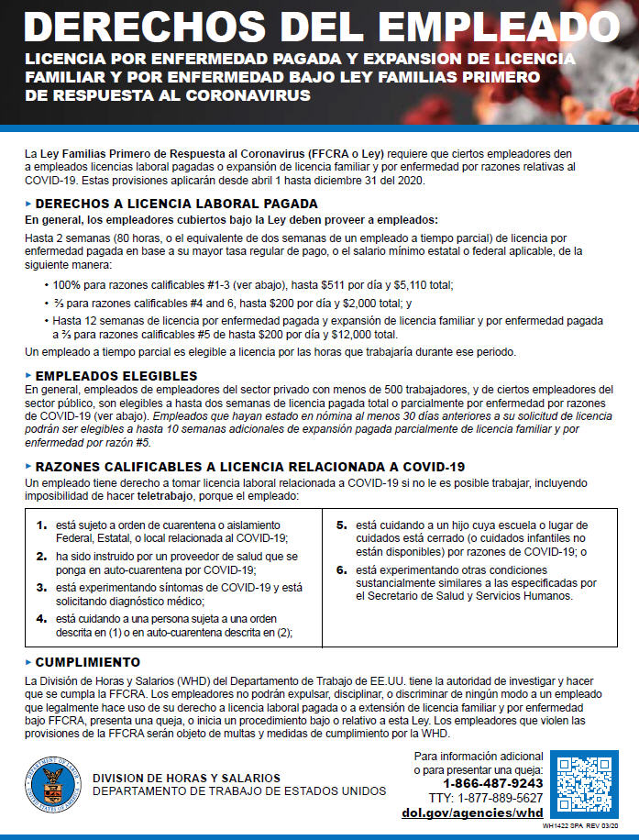

Slide 8
Duty of reasonable accommodation
Some laws require more than mere non-discrimination; they also impose an affirmative duty on the employer to accommodate certain conduct that it otherwise would not accept. The two most common examples of these are: (1) the duty to “reasonably accommodate” a disability under the Americans with Disabilities Act, and (2) the duty to accommodate certain conduct based on religious beliefs under Title VII of the Civil Rights Act of 1964.
www.hrflorida.org

Slide 11
First Thoughts?
www.hrflorida.org

Slide 12
www.hrflorida.org

Slide 13
Abercrombie & Fitch
Samantha Elauf, a Muslim, applied for a job at an Abercrombie & Fitch store wearing a headscarf or hijab.
She was denied hire for failing to conform to the company's "look policy," which Abercrombie claimed banned head coverings.
EEOC lawsuit charging that the company refused to hire Elauf due to her religion, and that it failed to accommodate her religious beliefs by making an exception to its "look policy" prohibiting head coverings
www.hrflorida.org

Slide 14
Title VII does not demand mere neutrality with regard to religious practices—that they be treated no worse than other practices. Rather, it gives them favored treatment, affirmatively obligating employers not “to fail or refuse to hire or discharge any individual . . . because of such individual’s” “religious observance and practice.” An employer is surely entitled to have, for example, a no-headwear policy as an ordinary matter. But when an applicant requires an accommodation as an “aspec[t] of religious . . . practice,” it is no response that the subsequent “fail[ure] . . . to hire” was due to an otherwise-neutral policy. Title VII requires otherwise-neutral policies to give way to the need for an accommodation. EEOC v. Abercrombie & Fitch Stores, Inc., 135 S. Ct. 2028, 2034 (2015)
Justice Scalia 8-1
www.hrflorida.org

Slide 15
The employer is obligated to reasonably accommodate a religious belief or practice, unless the accommodation would cause an undue hardship.
“Undue hardship” refers to any act that requires an employer to bear greater than a de minimis cost in accommodating an employee’s beliefs.

Slide 16
Reasonable accommodations may include:
exceptions to appearance guidelines,
changes in schedules,
providing places to pray, and
leave time for religious observances.

Slide 17
She did not ask for a religious accommodation!

Slide 18
This was Title VII – not the ADA
The Tenth Circuit directed summary judgment on the ground that Elauf did not inform Abercrombie of her need for a religious accommodation.
The Supreme Court rejected this view, stating “an applicant need only show that his need for an accommodation was a motivating factor in the employer’s decision,” Title VII does not impose a knowledge requirement, although some anti-discrimination statutes do.

Slide 29
Employer’s position:
Because the hand scanner system would not imprint a physical mark on the employee’s hand, there was no conflict between the employee’s beliefs and the employer’s requirement that he use the hand scanner system.

Slide 30
Jury verdict for employee
awarded the employee $436,860.74 in front and back pay and lost benefits, and issued a permanent injunction against the employer

Slide 31
Making a Jehovah’s Witness answer the business phones with the greeting “Merry Christmas.”
Is this legal? (poll)

Slide 33
Once an employee’s prima facie case has been established, the employer must then prove that an accommodation to the employee’s beliefs will result in some undue hardship, but this was not done in this case.
The Court looked to see whether something more than a de minimis cost in the form of either lost efficiency or wages existed to constitute undue hardship which will relieve an employer of its duty to accommodate the religious beliefs of its employees

Slide 34
How can this employer accommodate this?

Slide 35
The company could have accommodated the employee’s religious beliefs without undue hardship to its business.
“This could have been accomplished by not requiring her to answer the phone during this season or she could have merely answered with the greeting “Good Morning.”

Slide 38
Muslim applicant explained that he wears a beard as part of his religious observance. The hiring official replied that “God would understand” if he shaved his beard to get a job.

Slide 39
Another applicant explained that he wore his hair long as part of his religious observance and offered to wear it under his shirt or in a hair net, but was told, “No hair cut, no job.”

Slide 40
Rastafarian requested a religious accommodation to permit him to wear dreadlocks and refrain from cutting his hair, as his religious practice required.
His manager ignored his request, told the employee he “didn’t want any employees looking like women on his management team.”

Slide 43
Americans with Disabilities Act
EE must show that (1) he has a disability; (2) he is a qualified individual; and (3) he was subjected to unlawful discrimination as the result of his disability.
The determination of whether an employee’s impairment “substantially limits major life activities” is made on a case-by-case basis.
One way to show that an individual has a “disability” under the ADA is to allege that they have a physical or mental impairment that substantially limits one or more major life activities.

Slide 44
PTSD

Slide 54
Americans with Disabilities Act
An “impairment” includes any physiological disorder or condition affecting one or more body systems.
A “major life activity” is defined as the operation of a major bodily function.
The term “substantially limits” is construed broadly in favor of expansive coverage.

Slide 55
Does the ADA Require Automatic Reassignment to Another Position?

Slide 56
A 20-year employee suffered from a “gait dysfunction” from spinal stenosis and a hip replacement.
She provided a doctor’s note requiring that she use a cane.
Employer determined that her use of a cane posed a safety hazard in her specific department.
The employee sought a reasonable accommodation in the form of a job reassignment to another department where she could use her cane.

Slide 57
Does the employer have to transfer her?
Or is it adequate to give her the opportunity to apply for other jobs for the employer, but require her to compete for them?

Slide 58
When the employee did not obtain another position within 30 days, the employer terminated her employment and EEOC sued the employer on behalf of the employee. United States EEOC v. St. Joseph's Hosp., Inc., 2016 U.S. App. LEXIS 21768, (11th Cir. Dec. 7, 2016)
Who won?

Slide 59
The EEOC argued that the ADA mandates noncompetitive reassignment.
11th Cir. rejected the EEOC’s argument, and found the ADA does not require reassignment without competition for, or preferential treatment of, the disabled.

Slide 60
“The ADA provides that, subject to exceptions irrelevant here, an employer must reasonably accommodate a disabled employee. But it does not say how an employer must do that. It offers a non-exhaustive list of accommodations that ‘may’ be reasonable, and one item on the list is ‘reassignment to a vacant position…The ADA does not say or imply that reassignment is always reasonable.”

Slide 61
“Requiring reassignment in violation of an employer's best-qualified hiring or transfer policy is not reasonable ‘in the run of cases.’ As things generally run, employers operate their businesses for profit, which requires efficiency and good performance. Passing over the best-qualified job applicants in favor of less-qualified ones is not a reasonable way to promote efficiency or good performance.”

Slide 62
* footnote
“just because reassignment to a vacant position in violation of an employer's best-qualified hiring policy is not always required as a reasonable accommodation [this] does not mean it never will be….[A] plaintiff can show that special circumstances warrant a finding that reassignment is a required accommodation under the particular facts of her case.” But the employee in this case failed to show special circumstances.

Slide 63
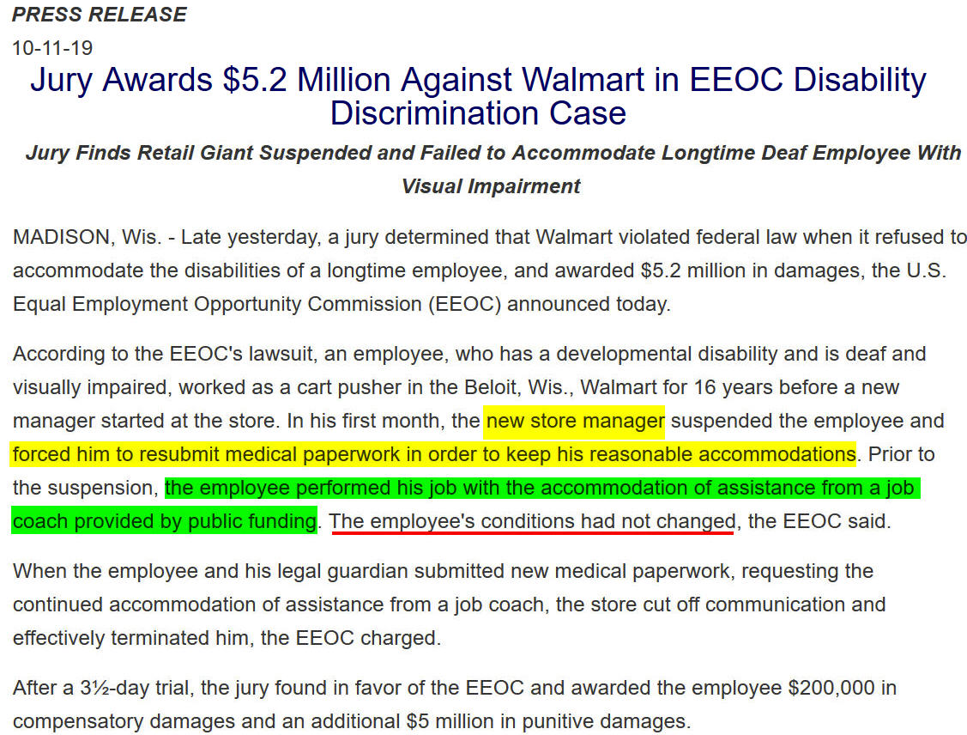
www.hrflorida.org

Slide 64
Grooming policy
All personnel are expected to be dressed and groomed in a manner that projects a professional and businesslike image while adhering to company and industry standards and/or guidelines. Hairstyle should reflect a business/professional image. No excessive hairstyles or unusual colors are acceptable.
www.hrflorida.org

Slide 65
www.hrflorida.org

Slide 66
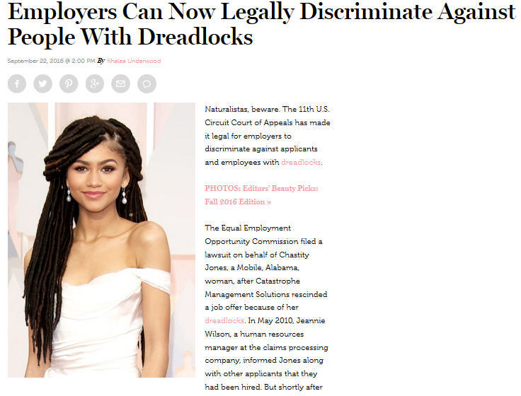
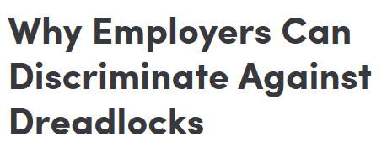
www.hrflorida.org

Slide 67
EEOC v. Catastrophe Mgmt. Sols., 852 F.3d 1018 (11th Cir. 2016)
Have employers been careful since Sept 2016?
www.hrflorida.org

Slide 68
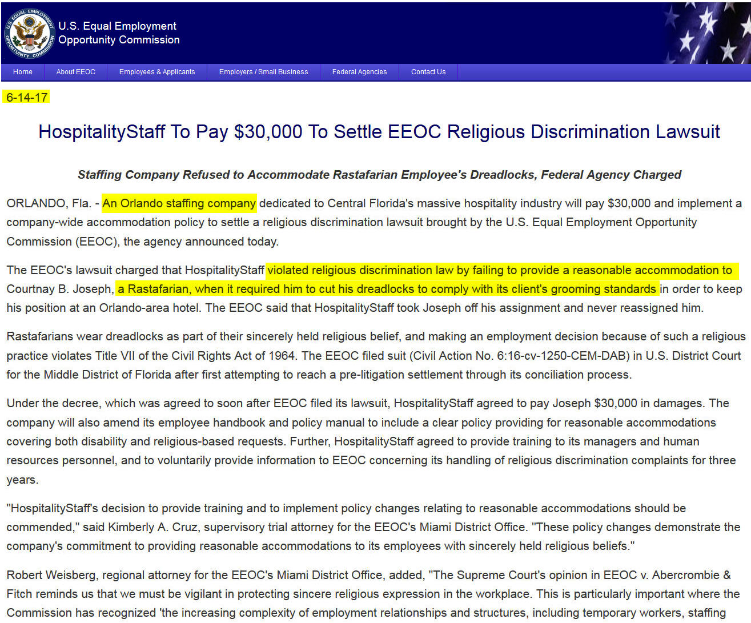
www.hrflorida.org

Slide 69
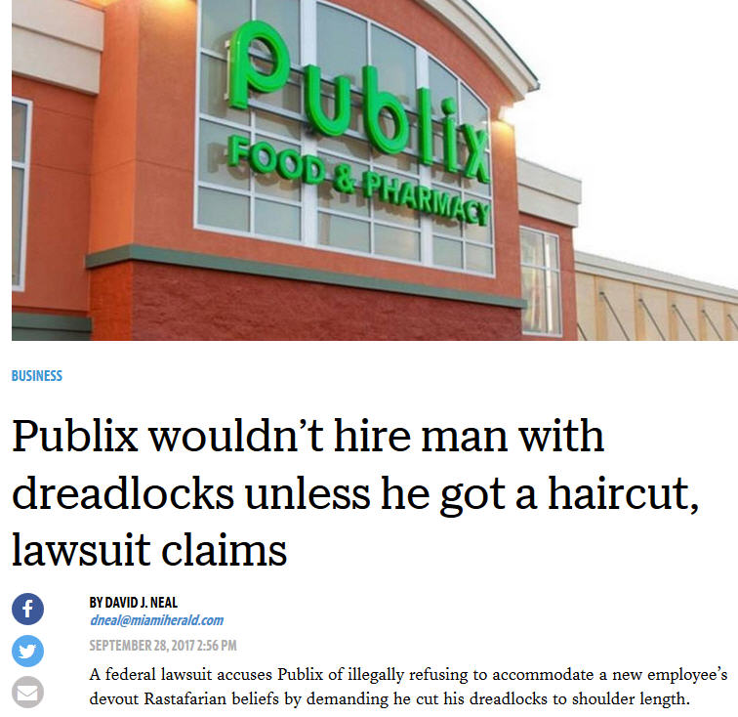
www.hrflorida.org

Slide 70
The Supreme Court in Young v. United Parcel Services Inc., 135 S. Ct. 1338 (2015) held that an employer’s refusal to accommodate could constitute unlawful discrimination if such accommodations were routinely granted to non-pregnant employees.

Slide 71
The employer’s burden of proffering a legitimate, non-discriminatory reason for denying the accommodation must be more than a claim that it is more expensive or less convenient to add pregnant women to the category of those whom the employer accommodates.

Slide 79
When a pregnant employee started wearing capri pants instead of the usual hot pants uniform and added a second layer of clothes to the usual tight top because of her pregnancy, the general manager told her that the owner would not approve, and forced her off the job.
Off the Air, II, Inc., d/b/a Nick’s Sports Grill recently settled the lawsuit. In addition to paying the bartender $24,000, it also agreed to a three-year consent decree.

Slide 80
Can you fire a worker if she cannot work after using up all 12 weeks of her leave under the Family Medical Leave Act?

Slide 81
Who is a “covered employer” under FMLA?
A private employer with 50 or more employees during 20 or more workweeks in the current or previous calendar year
Any public employer (regardless of the number of employees employed) including state, local and federal employers, and local educational agencies.
Public and private elementary and secondary schools are covered employers, regardless of the number of persons employed.

Slide 82
Who is an Eligible Employee?
1. Worked at least 1,250 hours of service during the 12 months immediately preceding the start of the leave
and
2. Worked at least 12 months (need not be consecutive; but do not count a break in service of 7 years or more, unless National Guard or Reserve Military service, or written agreement (e.g., CBA) exists)
and
3. Is employed at a worksite where 50 or more employees are employed by the employer within 75 miles of the worksite

Slide 83
Qualifying Reasons for Taking FMLA Leave
FMLA allows eligible employees of covered employers to take up to 12 workweeks of job-protected leave in a 12-month period for the following:
1. Birth of a son or daughter, and to care for the newborn child;
For placement with the employee of a son or daughter for adoption or foster care;
To care for the employee’s spouse, son, daughter, or parent with a serious health condition;
Because of a serious health condition that makes the employee unable to perform the functions of the employee’s job;
Qualifying Exigency; and
6. Military caregiver leave (26 workweeks in single 12-month period)

Slide 84
REASON FOR LEAVE: Serious Health Condition
“Serious health condition” means an illness, injury, impairment or physical or mental condition that involves inpatient care or continuing treatment by a health care provider

Slide 85
FMLA return
If an employee is unable to return to work and perform the essential functions of his or her position due to a physical or mental condition, including the continuation of the serious health condition after expiration of the employee’s FMLA entitlement, the employee has no right under the FMLA to restoration to another job position. 29 C.F.R. § 825.216(c). However, the employer may have such an obligation under the Americans With Disabilities Act.

Slide 91
Americans with Disabilities Act of 1990 (“ADA”)
Prohibits all employers with 15 or more employees from discriminating against qualified disabled individuals with regard to any term, condition or privilege of employment.
The ADA protects any qualified individual with a disability, which means an individual with a disability who, with or without reasonable accommodation, can perform the “essential functions” of the employment held or desired.

Slide 92
Additional leave
A leave of absence might be a reasonable accommodation in some cases if it would allow an employee to continue work in the immediate future.
But an accommodation is unreasonable if it would only allow an employee to work at some uncertain point in the future.

Slide 93
Is the condition likely to be fully corrected, or nearly so, at some point in the near future?
An accommodation is probably unreasonable unless it would allow the employee to perform the essential functions of their jobs presently or in the immediate future.
Look to see whether the disabling condition is temporary (not chronic).
What is not temporary?
fourteen-year history with cluster headaches
ten-year history with high blood pressure

Slide 94
Indefinite leave is not required
A request for indefinite leave is not a “reasonable” accommodation because such a request does not allow the employee to perform the essential functions of the job in the near future.

Slide 95
Luke v. Bd. of Trustees of Fla. A & M Univ., 674 F. App’x 847, 850 (11th Cir. Dec. 22, 2016)
(holding request for additional leave of six months unreasonable where plaintiff had already received nine months of leave).

Slide 96
Application of a “per se” rule is impermissible
an individualized inquiry should be made, even if the leave exceeds what would normally be considered reasonable

Slide 97
Can a blind person sue your business because he can’t navigate your website?
www.hrflorida.org

Slide 98
Which employers are covered by Title III of the ADA?
Title III prohibits discrimination on the basis of disability in the activities of places of public accommodations (businesses that are generally open to the public and that fall into one of 12 categories listed in the ADA, such as restaurants, movie theaters, schools, day care facilities, recreation facilities, and doctors' offices) and requires newly constructed or altered places of public accommodation—as well as commercial facilities (privately owned, nonresidential facilities such as factories, warehouses, or office buildings)—to comply with the ADA Standards.
www.hrflorida.org

Slide 99
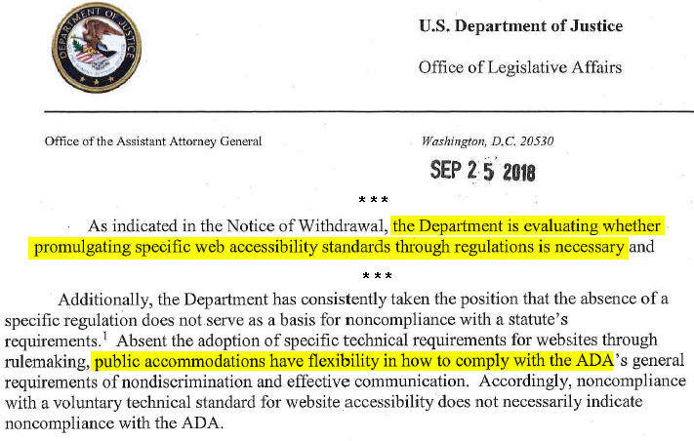
www.hrflorida.org

Slide 100
Questions? Newsletter?
David Miklas Law Office of David Miklas, P.A. Representing Florida Employers Since 1998 www.MiklasEmploymentLaw.com
/FloridaEmploymentLaw
Email: david@miklasemploymentlaw.com

