Slide 1
FMLA & Military leave
How do they intersect?
Presented by Brooke Ehrlich, Esq.
Weiss Serota Helfman Cole & Bierman

Slide 2
National defense authorization act of 2008
Military Caregiver Leave
Qualifying Exigency Leave

Slide 3
National defense authorization act of 2010
What was involved?

Slide 4
What is “qualifying exigency leave?”

Slide 5
An employee may use “qualifying exigency leave for the following purposes:
Short-notice deployment
Military events and related activities
Childcare and school activities
Financial and legal arrangements
Counseling services
Rest and recuperation
Post-deployment activities
Additional related activities

Slide 6
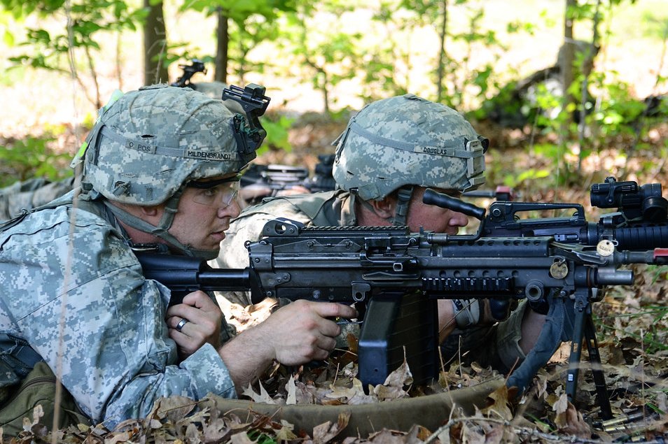
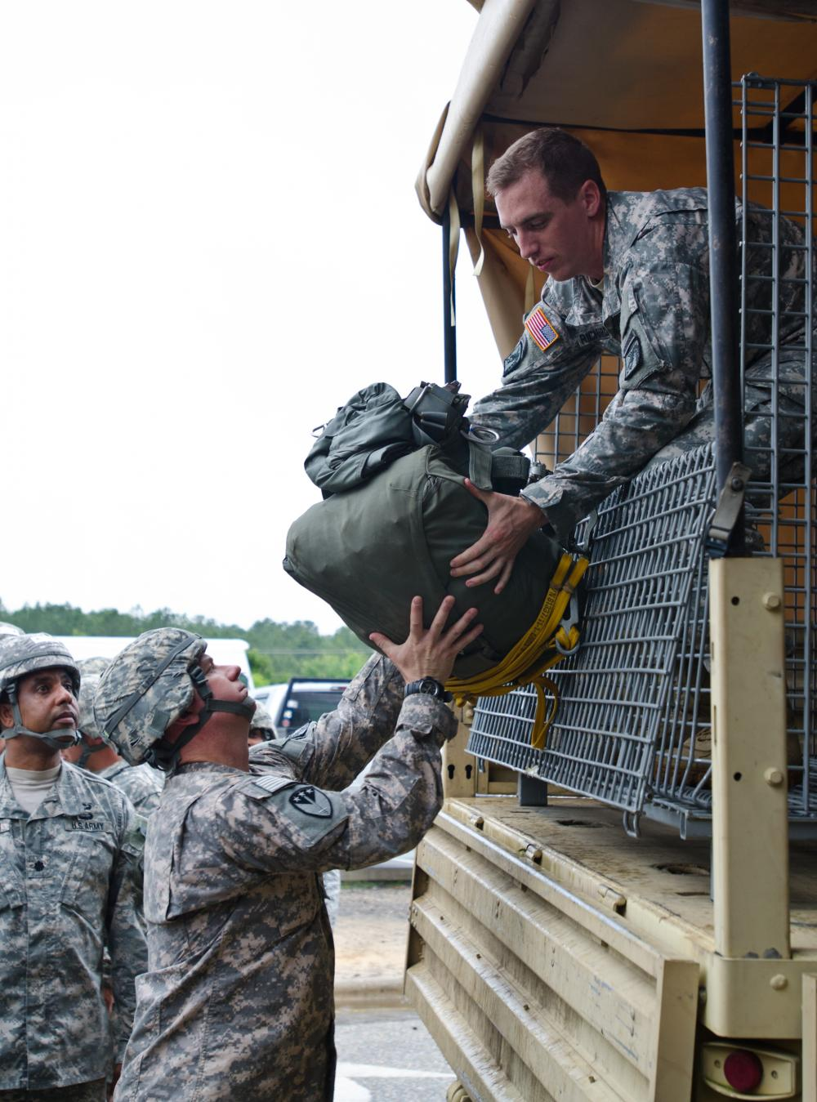
What is “covered active duty?”

Slide 7
military caregiver leave
What is it?
How does it impact your employees?

Slide 8
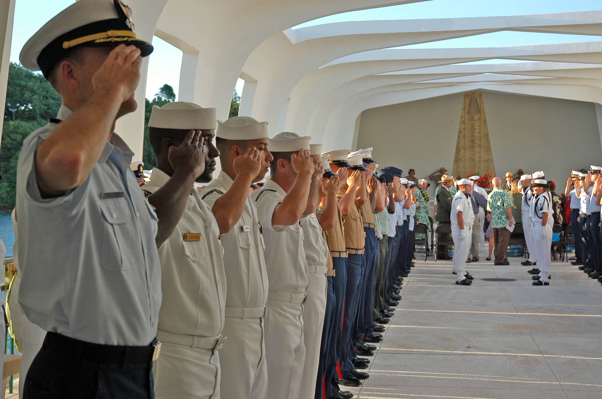
Who is a “covered servicemember?”

Slide 9
Who is a “covered veteran?”

Slide 10
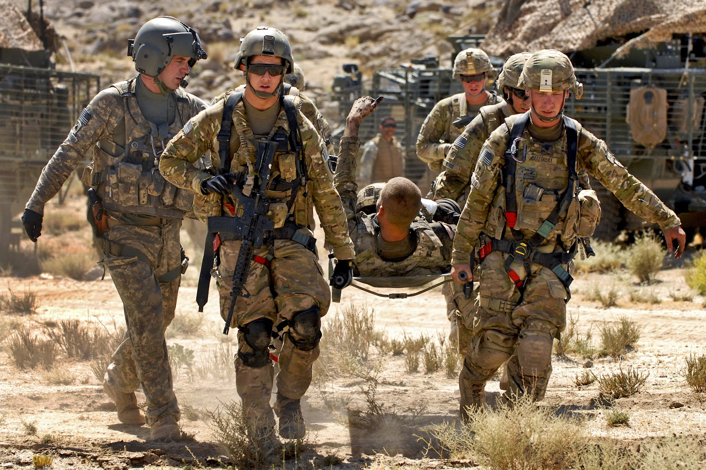
how is “serious injury or illness defined?”

Slide 11
how are pre-existing injuries or illnesses handled?

Slide 12
What health care providers are authorized to certify the leave?

Slide 13
The foreign deployment requirement
What does this mean?
How does it impact qualifying exigency leave?

Slide 14
enforcement
It is unlawful for any employer to interfere with, restrain, or deny the exercise of or the attempt to exercise any right provided by the FMLA.
It is also unlawful for an employer to discharge or discriminate against any individual for opposing any practice, or because of involvement in any proceeding, related to the FMLA.

Slide 15
Common questions
Am I required to pay my public-sector employee who takes a leave of absence for military training?
How long am I required to “hold” the position of an employee who is on military leave of absence?
How do I handle an employee who, I suspect, is abusing the system by volunteering for military training?

Slide 16
Tips for curbing fmla abuse
Use written leave request forms.
Question employees, and then question them some more.
Call-in procedures still apply.
Check in periodically re status.
Medical certification is key, require certification when applicable.
Review patterns of absences.
Update your FMLA policy and procedures.
Surveillance? Yes, but be very careful.

Slide 17
Recent fmla cases
Moore v. GPS Hospitality Partners
Many courts have upheld a two-call notice requirement (for example, supervisor and HR or HR and third-party leave administrator).
Repeatedly found such procedures lawful and upheld denial of FMLA leave based on failure to follow two-call procedure.
The requirement that employees must follow “usual and customary notice and procedural requirements” to obtain FMLA does not permit employers to deny leave based on a failure to comply with more stringent notice requirements applicable only to FMLA requests.
Cannot deny or delay FMLA leave based on notice requirement more rigorous than what is required for other types of leave.

Slide 18
Recent fmla cases
Holladay v. Rockwell Collins, Inc.
Employee approved for intermittent leave for migraines.
Absent from work four consecutive days .
Left a voicemail for her supervisor to report her absence each day.
Dispute as to content of voicemails – “migraine,” “illness,” “doctor’s visit.”
Court found that if she cited migraines as the reason for her absence, company should have designated her absences as FMLA.
If she only said she was ill, her notice was deficient.
Company also argued that she failed to comply with its requirement to provide a doctor’s note prior to the start of her shift on the fourth day of absence.
Court found this policy more onerous than FMLA medical certification requirements and could not be used to deny FMLA.

Slide 19
Recent fmla cases
Evans v. Cooperative Response Center
Employer maintained a point-based attendance system.
Employee exceeded the absences indicated on her FMLA certification form.
Employer asked her doctor to recertify the additional absences.
Doctor did not increase the number of absences employee would need to be absent but referred employer to the previous certification.
Employee assessed points for absences that exceeded the number on the certification, and she was later terminated for those absences.
Court found that the employer lawfully denied employee FMLA leave for the absences in excess of those certified.

Slide 20
Recent fmla cases
Robinson v. MGM Grand Detroit
Employee filed suit claiming, among other things, retaliation for taking FMLA leave.
Employer sought and then filed a motion to compel discovery from, employee’s private social media accounts.
Specifically, Facebook posts, Google photos, and Google location data.
Court granted motion finding that the requests were relevant to:
Employee’s activities during the time he claimed to need FMLA leave and was unable to work
Potential FMLA abuse
Not an open door to employees’ social media accounts – in order to obtain this evidence, must show from evidence already obtained that social media accounts are likely to yield evidence directly related to claims or defenses

Slide 21
Thank you!
Brooke Ehrlich
(954) 763-4242
Behrlich@wsh-law.com

